Slide 1

Welcome to our presentation
Group members
MD. Abu Hosen Shawon
ID : 161-35-1420
Kamruzzaman
ID : 161-35-1559

Slide 2
Toll management
Name of our project :

Slide 3
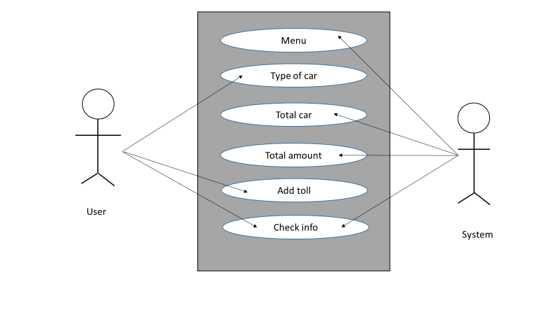
The use case diagram

Slide 4
Project description
Running software
Start program
Password
Menu of car
Car type and amount
Select car
Add toll
Toll the car
Total toll & car
Exit

Slide 5
Start program
Firstly, we opened this program…
Password
In this function we have to entering password,if password is correct program can be open,
Otherwise, it can not be open.
Menu of car
This is the main menu of cars toll management. Here we can show car type & it’s amount.
Car type & amount
There are three type of car : light, medium & heavy .
Those three type of car caries three type of amount they are : 50 for light,100 for medium & 150 for heavy car.

Slide 6
Select car
To select a car you have to press : 1=Light, 2=Medium or 3=Heavy.
Add toll
In this option we have to add the toll for the cars. Then the process will continued.
Toll the car
This is the final option of our project. In this option we can see the total number of the car & total amount of the car. Then we have to easily collect toll of the all car. That’s why our system work perfectly.

Slide 7
Total toll & car
This function shows total numbers of car & total toll in a day.
Exit
This where we exit the program, if you don’t want to exit then click 1,2 or 3. Otherwise press 0 to exit.

Slide 8
How to work…

Slide 9
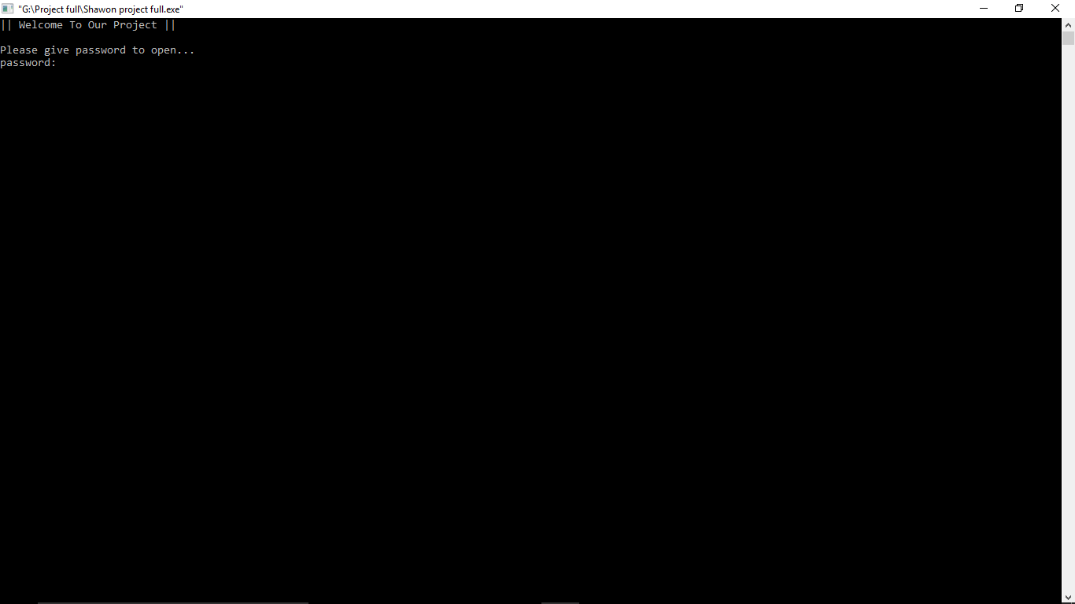

Slide 10
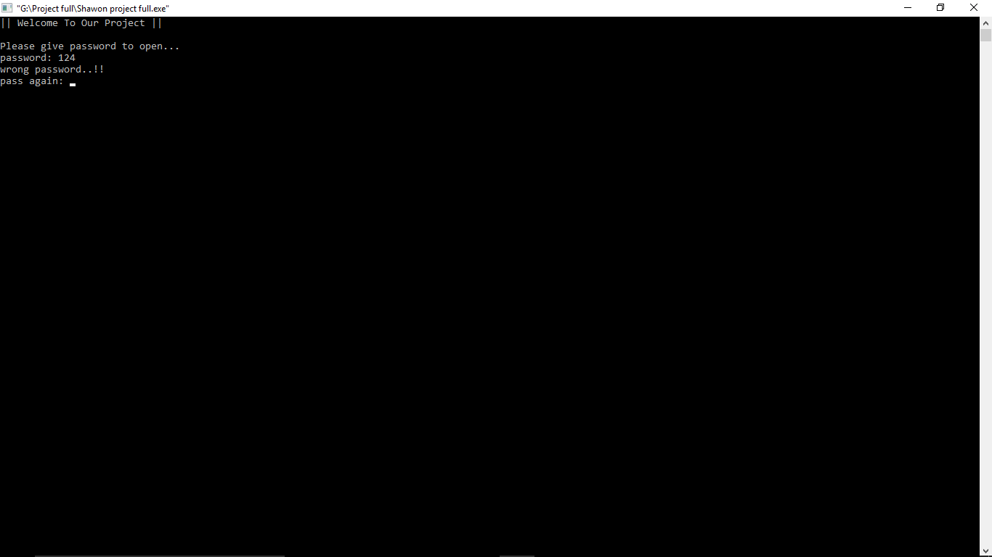

Slide 11


Slide 12
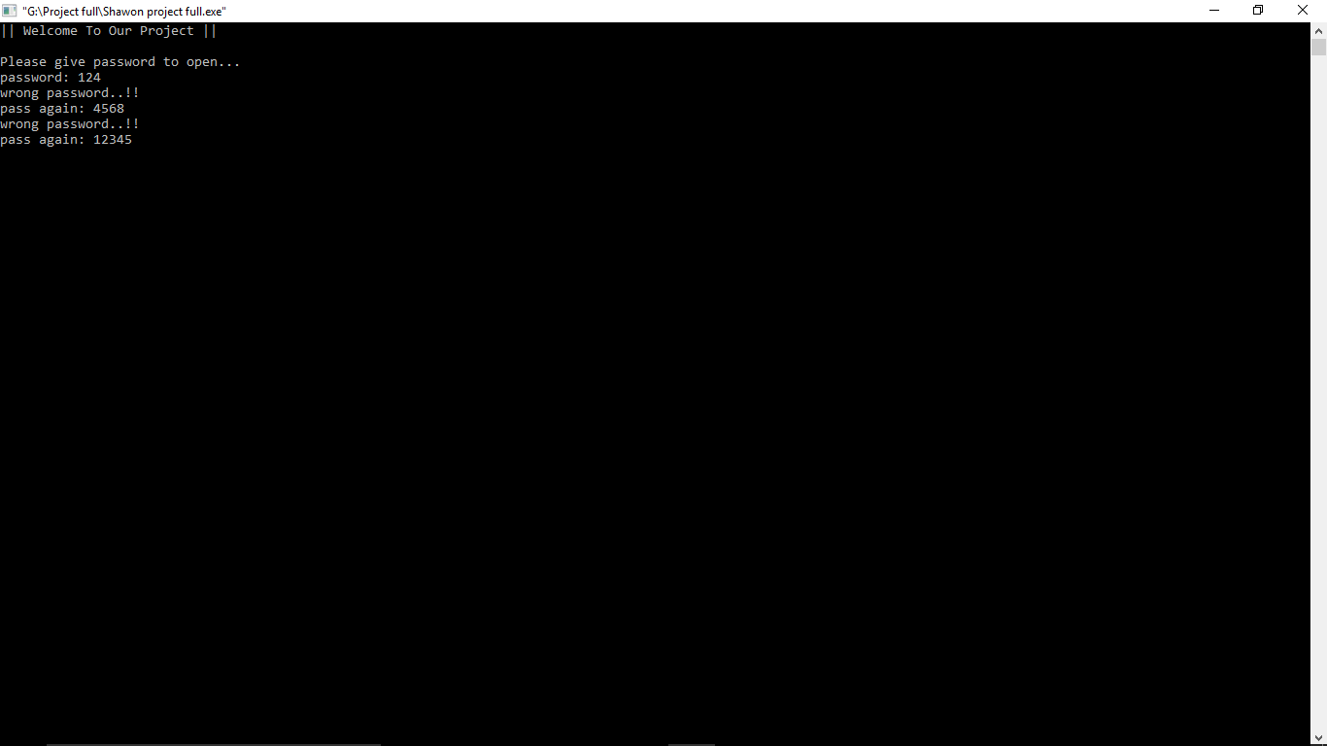

Slide 13
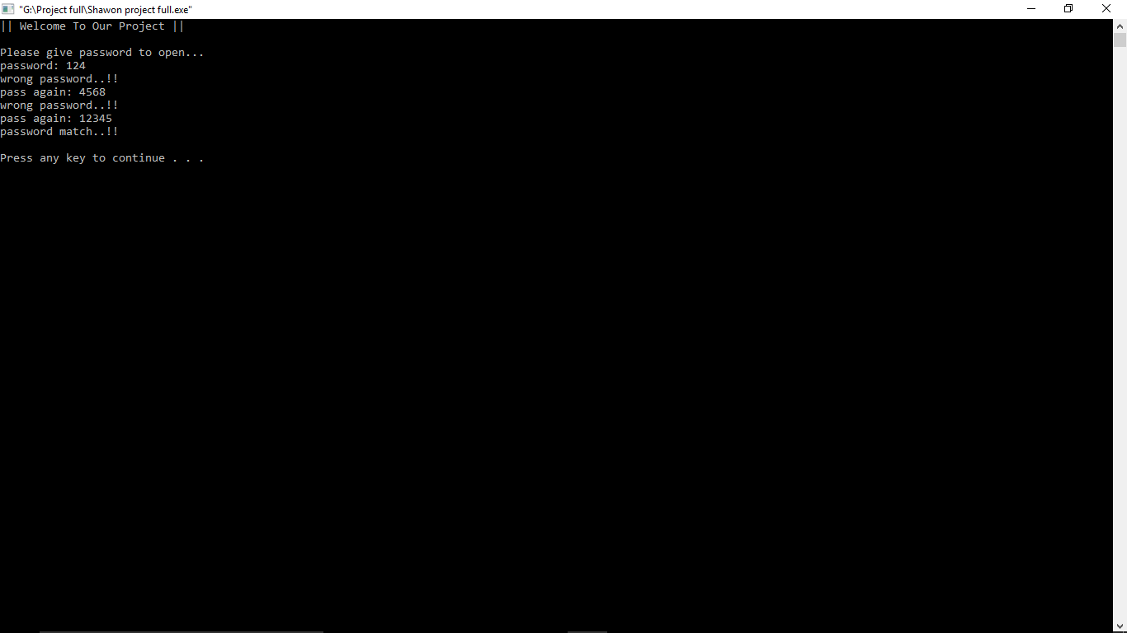

Slide 14
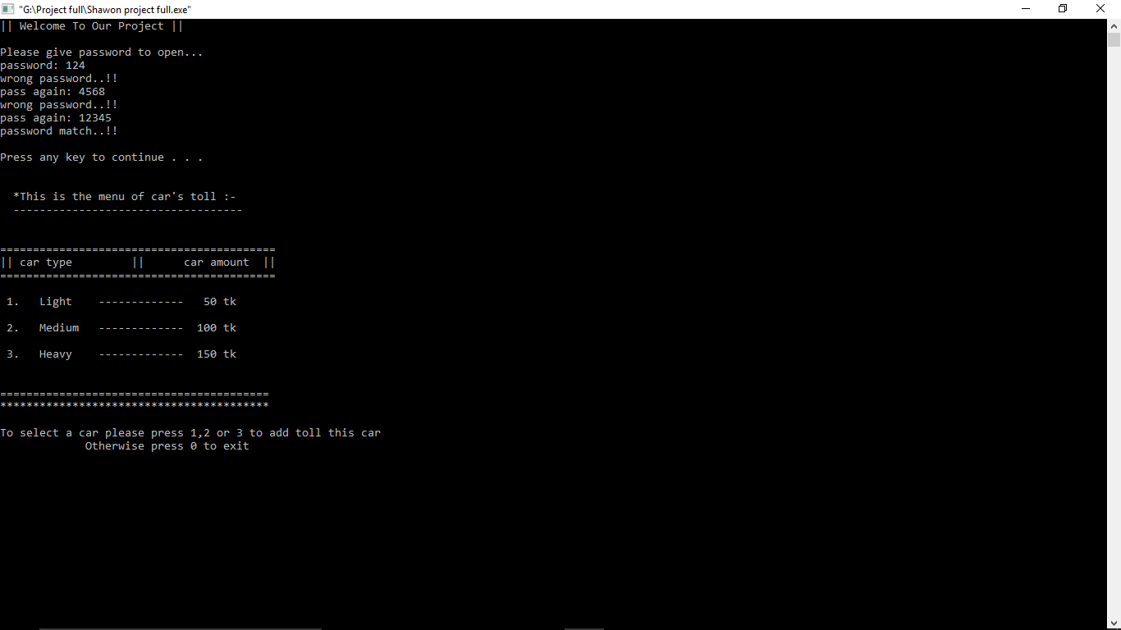

Slide 15
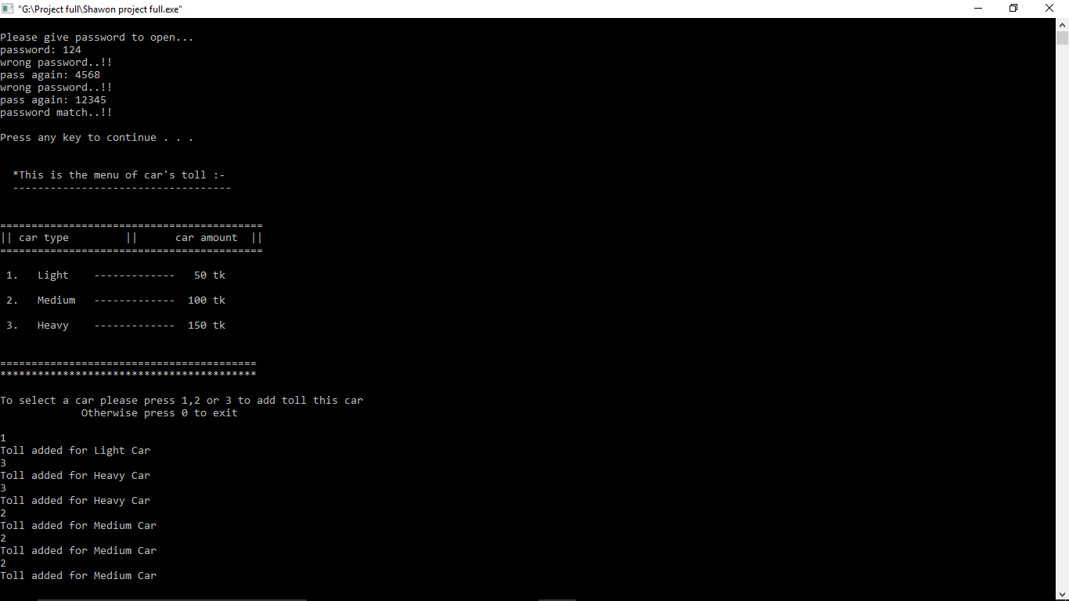

Slide 16
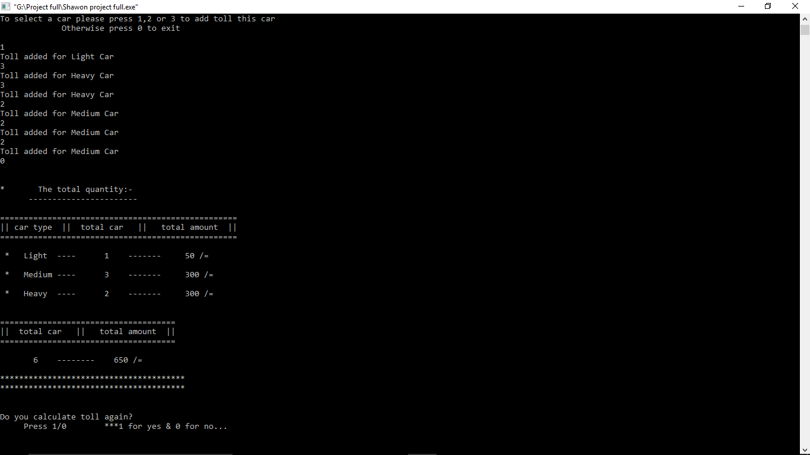

Slide 17
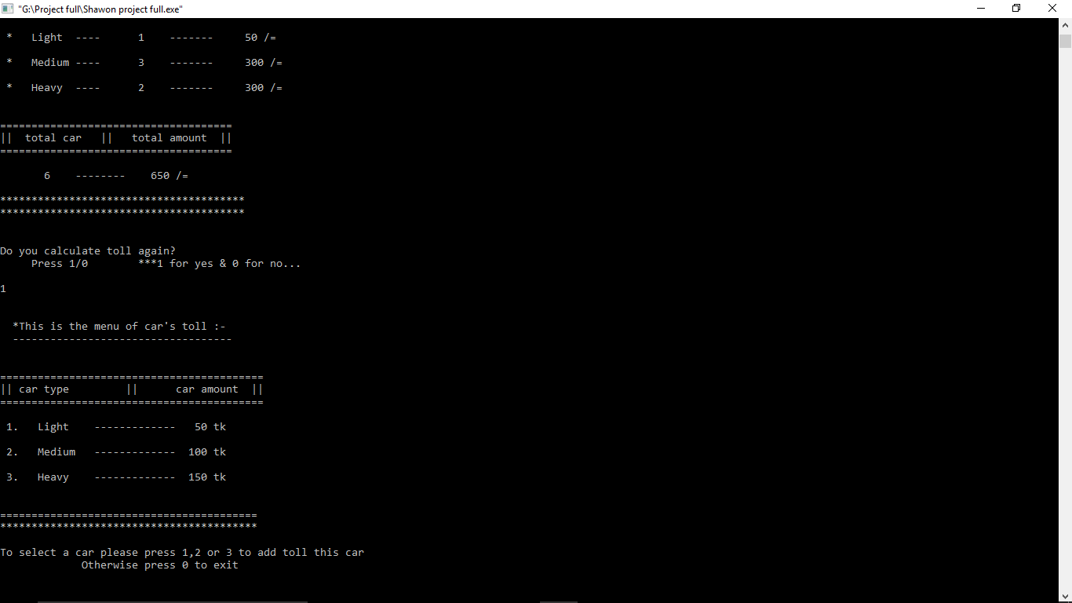

Slide 18
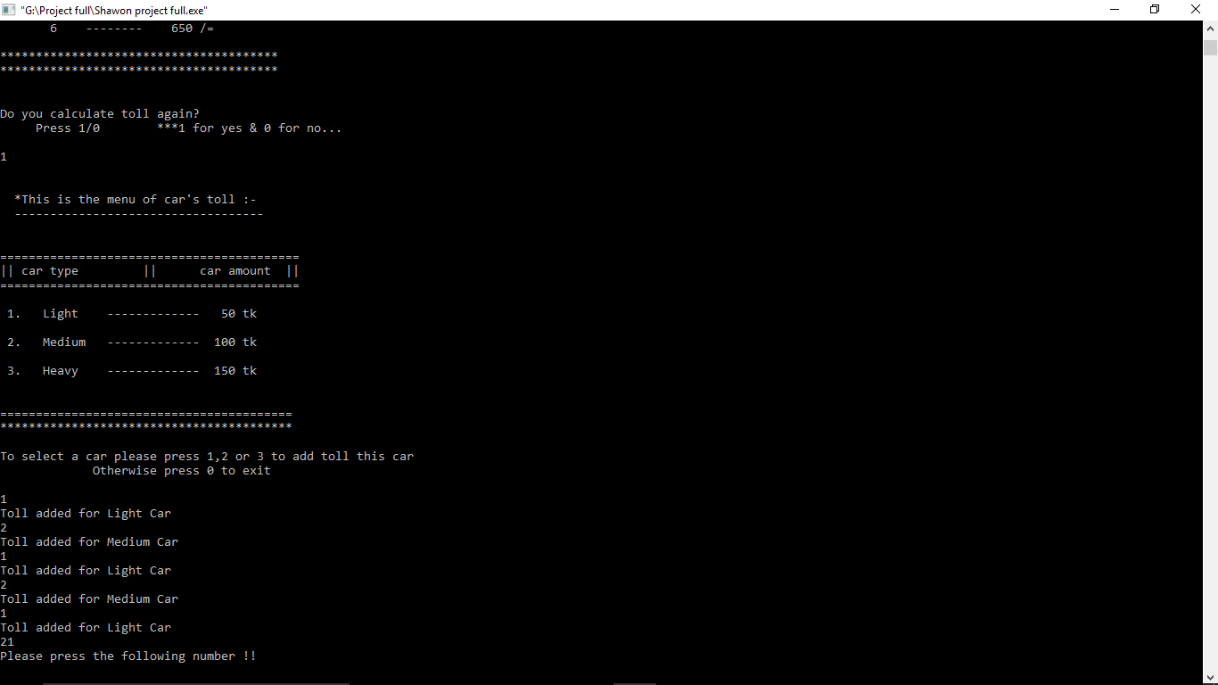

Slide 19
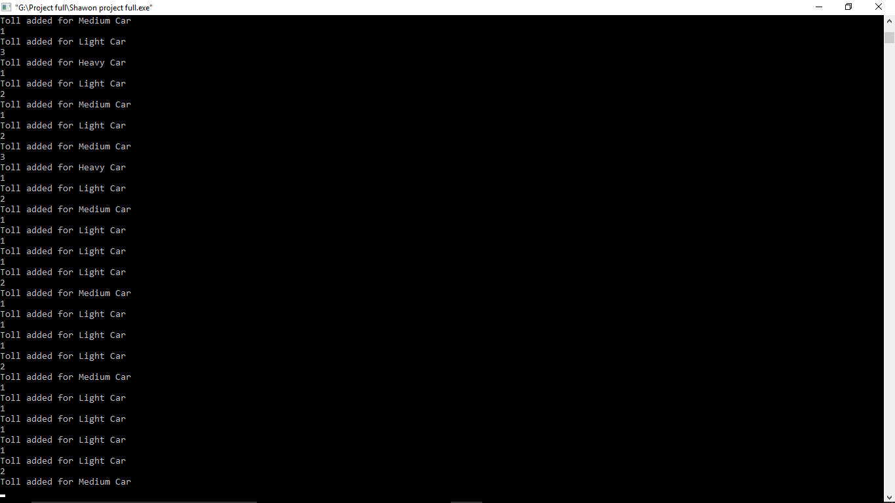

Slide 20


Slide 21
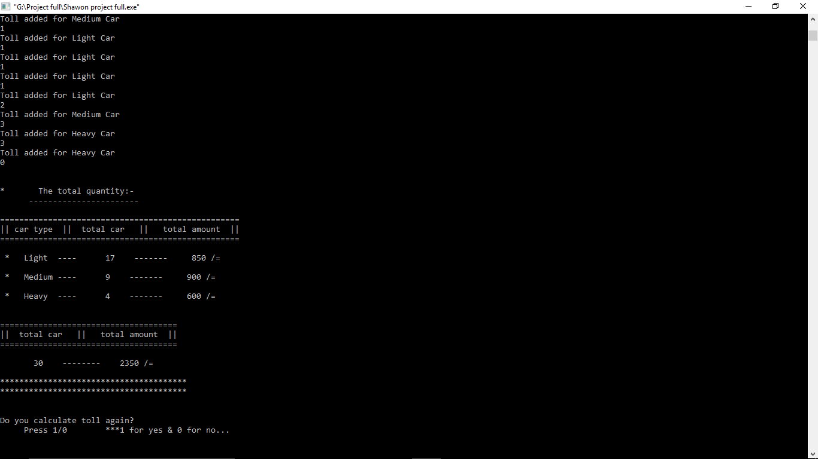

Slide 22
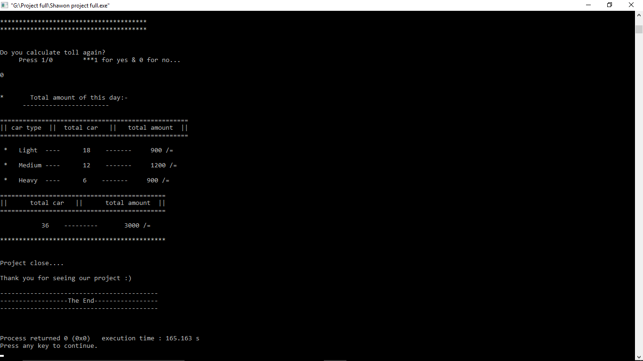

Slide 23
Upcoming Updates
We want to add some other functions such that motion sensor , voice sensor & many other.
Add some function if they will need in the future.
There will be an information center , If some one feel any kind of wrong then they discuss with us.

Slide 24


